Slide 1
Advanced Persistent Threat Attack Detection: An Overview
Bilal Ahmed Mir
BSCS-F19-M75
Section B

Slide 2
Domain:
APT
Espionage
APT Attack Detection
Annalyse already Identified of APTs
Detect possible APT attacks

Slide 3
Publication Date | 27 December,2014 International Journal of Advancements in Computer Networks and Its Security– IJCNS
Author | Ibrahim Ghafir and Vaclav Prenosil
Method | Research
Reference | M. de Kunder, “The size of the world wide web,” T. M. technical report, “Targeted attacks and how to defend against them,” Damballa, “Advanced persistent threats (apt),” M. Balduzzi, V. Ciangaglini, and R. McArdle, Targeted attacks detection with spunge,”

Slide 4
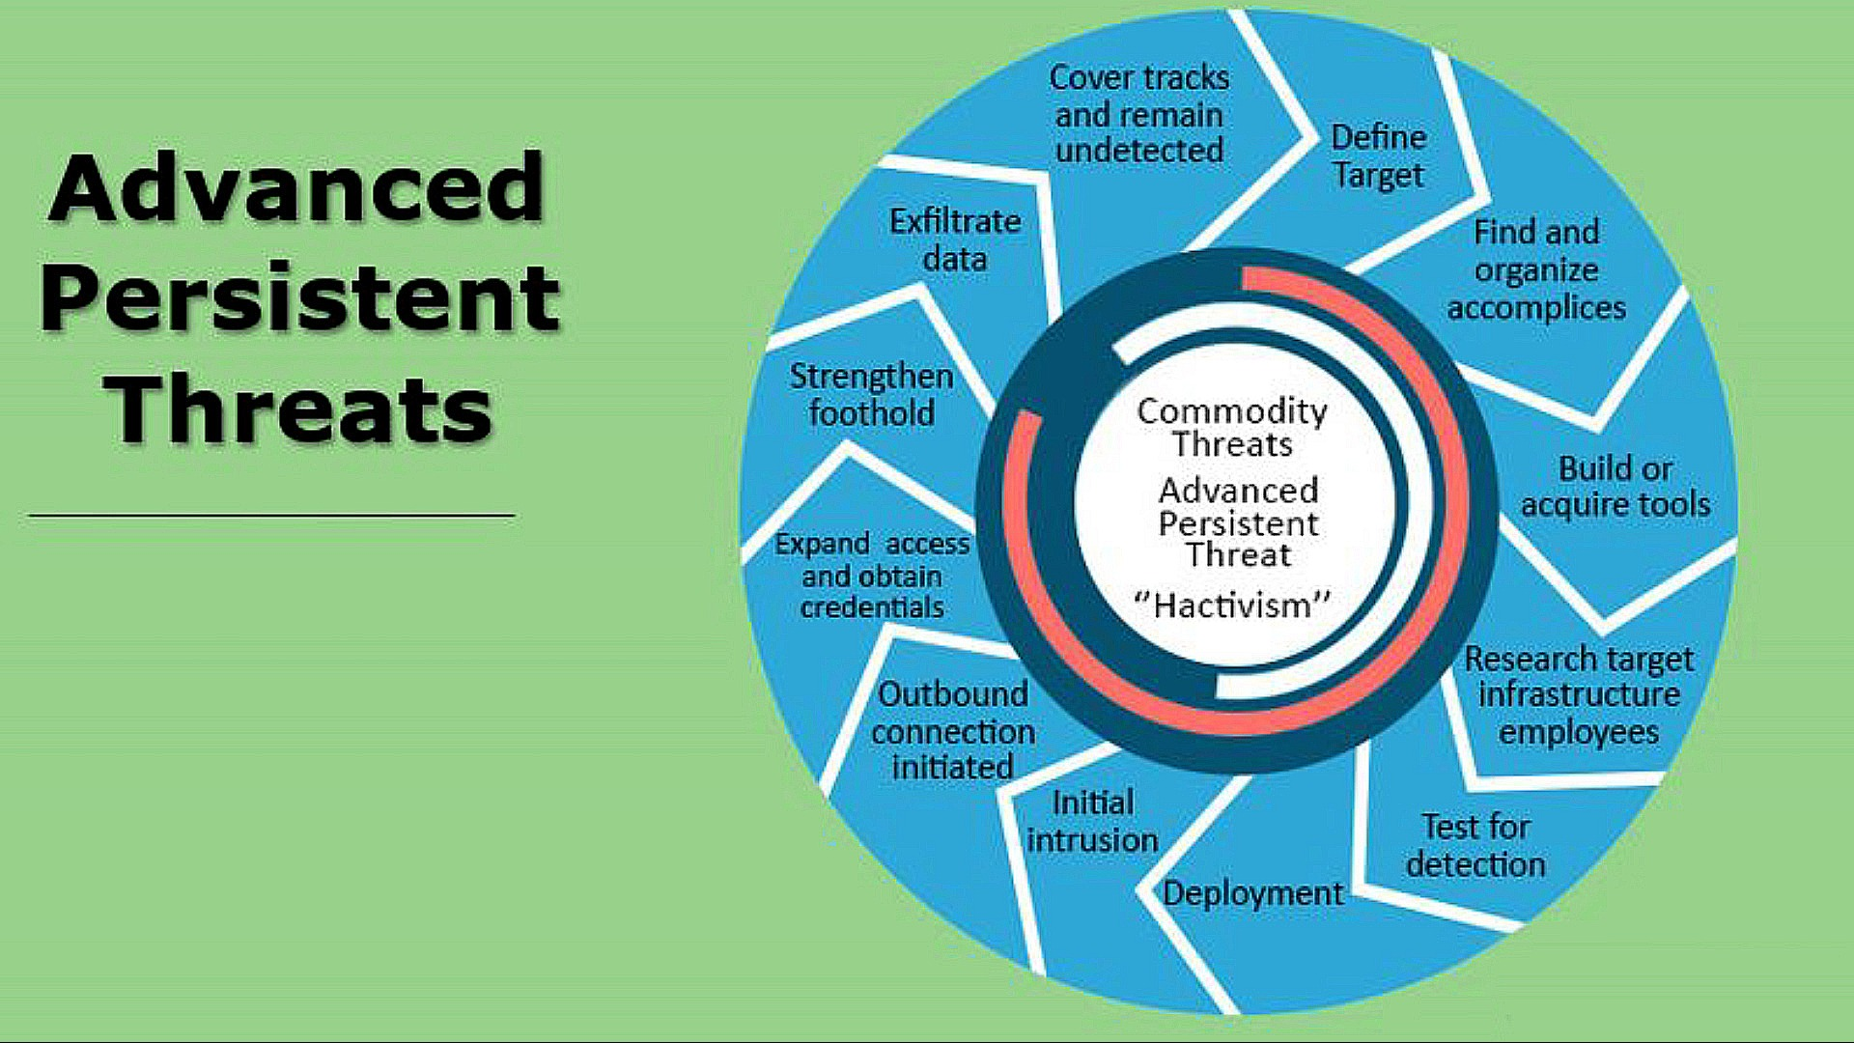
METHADOLOGY
Advance Persistent Threat

Slide 5
Previous Research Findings on APT Attack
Project Aurora
GhostNet
Red October
APT1
Pegasus
Analysing Already Identified of APTs
Detect Possible APT Attack

Slide 6
Conclusion
APTs are sophisticated version of multistep attacks
Huge Financial Loses
Hard to Detect
Change In Architecture Requires
Detecting APTs attack on the basis of corelation

Slide 7



